Slide 1
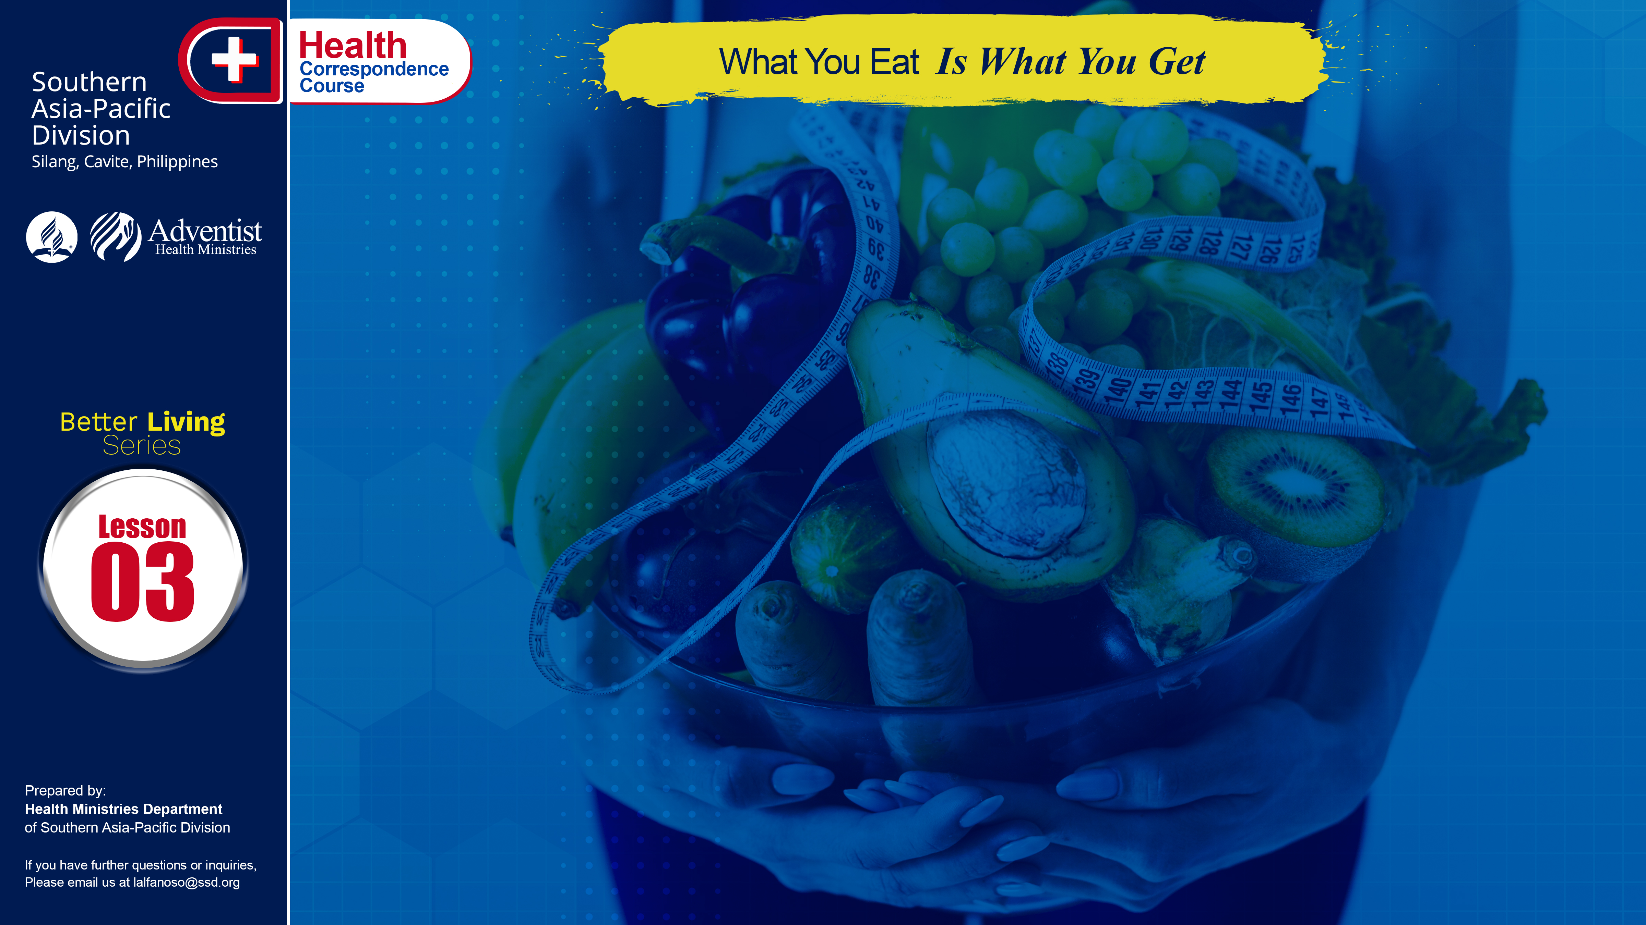

Slide 2
It was the Creator’s plan that the foods we eat should keep us young and healthy. Unfortunately, a great many people never give much thought to their diet. They will eat anything that may appeal to their perverted appetites. It would seem perfectly obvious to everyone that our bodies are built up entirely from the things we eat. We have no other way of getting these important substances into the system.

Slide 3
Choosing a sensible diet is not difficult. It is important to have plenty of variety in your diet. Food is divided into three major groups: the energy giving foods (carbohydrate), body building foods (protein), and body regulating foods (vitamins and minerals). Each nutrient or food groups has its own function in our body, that’s why a variety of foods is needed every meal to avail of those nutrients and to have a balanced diet. A balanced diet is one that supplies all the essential nutrients required to keep your body functioning perfectly well.

Slide 4
Energy Giving Foods
These are the carbohydrate rich foods like: rice, noodles, pastas, root crops (camote, potatoes, ube, and the like), corn, bread (other baked products) and cereals. These foods provide energy and strength for everyday activity. Fat rich foods also falls in this category but they should be use in very minimal amount.

Slide 5
Body Building Foods
In other term, these are the protein rich foods. These foods are especially needed in growing years of children, repairs body tissues, it also contributes energy and helps in making bones and teeth stronger, needed for growth, and repair and maintenance of the body. Protein of good quality can be obtained from both animal and plant sources. Milk and milk products, eggs, meat, fish, chicken, are protein foods of animal origin.
. . .

Slide 6
Body Building Foods
. . .
Plant proteins are contained in legumes (beans, peas, lentils, garbanzos, peanuts and the like), nuts, (walnuts, pecans, almonds, and cashew). Vegetables and fruits contribute only a small portion of protein.
Plant protein sources, if properly chosen and combined, can meet the needs for the essential amino acids and contribute to an adequate diet.

Slide 7
Body Regulating Foods
These consist mostly of green and yellow leafy vegetables and fruits Vitamins and minerals are essential substances for life and health. They regulate body processes. The nutrients interact, and the lack of one may affect the requirements or the functions of others. An adequate intake of all of them in everyday foods is essential for buoyant health.

Slide 8
Balance Diet
A balance diet is composed of these three basic food groups. In every meal these three should be present that a person may be able to have a balanced diet.
. . .

Slide 9
Balance Diet
. . .
Choose daily from each food group at least the minimum amounts. Include a protein food or milk or both with each meal. Choose a wide variety of wholesome, unrefined foods. Eat enough to maintain ideal weight. Breakfast, the first meal of the day shouldn’t be forgotten. It contributes to our whole day activity and if we had a good breakfast we are giving our body the very first fuel of the day that helps us be GOD’S WAY TO ULTIMATE HEALTH.

Slide 10
QUESTIONS:
Choosing a sensible diet is not difficult. TRUE/FALSE
Three basic food groups: energy giving, body building, body regulating TRUE/FALSE
Tell whether the following are carbohydrate rich/protein rich/vitamin rich:
Spaghetti, Hotdog, Camote tops, Pancit canton
Pineapple slices, Daing
They also contributes to energy giving foods but should be use in minimal amounts. ________
_______________, first meal of the day which shouldn’t be forgotten.

Slide 11
NAME: ______________________________________
ADDRESS: ______________________________________
AGE: ______________________________________

