Slide 1
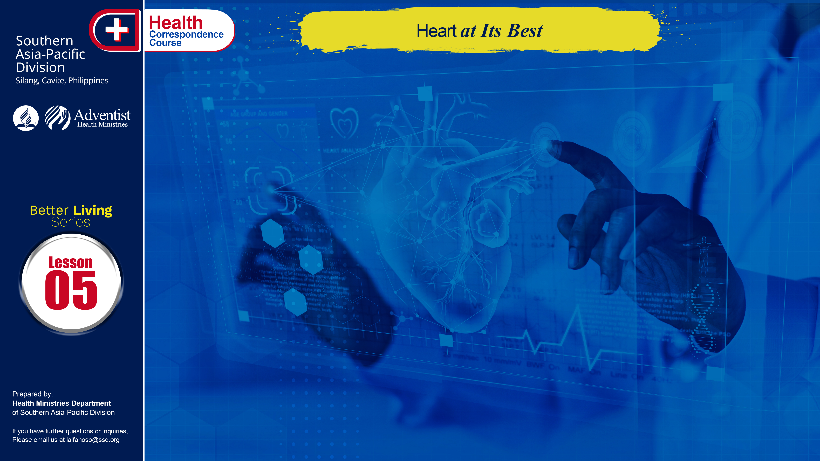

Slide 2
The organ upon which all others depend is the heart. Constantly, day and night, your wonderful heart continues to beat.
Heart disease is one of the leading causes of death and disease in many countries. In the Philippines, diseases of the heart and of the vascular system are classified as the second and fourth causes of death (1985 statistics). It is the biggest killer in the entire world. The latest statistics shows that over 954,000 people died of diseases of the heart and blood vessels (cardiovascular disease). Every 33 seconds an American dies of cardiovascular disease.

Slide 3
Sadly, deaths only tell part of the story of this dreadful disease. The annual cost to America for diseases of the heart and blood vessels is an astounding 259.1 billion dollars, which includes not only the medical and surgical treatment, but also lost productivity in the work force.

Slide 4
ANATOMY and PHYSIOLOGY
The human heart is a very efficient pump. It keeps the blood moving continuously throughout life and yet it is no larger than a man’s fist. This four chambered muscular organ beats 100,000 times and pumps 4,300 gallons of blood. The heart has two sides; each one has an atrium, a chamber in which blood collects, and a ventricle, a chamber which pumps blood out of the heart.
. . .

Slide 5
ANATOMY and PHYSIOLOGY
. . .
The circulating blood supplies oxygen and other nutrients to all organs and tissues of the body, including the heart itself. When the heart releases blood flows in as a result of the change in pressure. When the blood flowing through the heart and to the body is obstructed, then a disease condition develops. The most common of these are hypertension and atherosclerosis in which they are also interrelated to other heart problems.
. . .

Slide 6
HYPERTENSION
Blood pressure is the force exerted by the bloodstream against the walls of the arteries; hypertension is the term used for abnormally high blood pressure. Blood pressure varies with age, emotional state, activity level, and time of the day. It is expressed as two figures, the normal range being 110/80 to 140/90. The first higher figure in each pair is the systolic pressure which the peak pressure is reached when the heart contracts and forces blood into the arteries. The low figure is the diastolic pressure, the lower pressure when the heart rests between beats.
. . .

Slide 7
HYPERTENSION
. . .
Diastolic pressure is usually used to measure the severity of high blood pressure. A high- normal reading is 85-89; mild hypertension is 90-104; moderately severe hypertension is 105-114; and severe hypertension is 115 and higher. Two high readings on consecutive visits to the doctor are required before a diagnosis of hypertension is made, because even the stress and worry of the visit can be enough to cause blood pressure to rise above normal.
. . .

Slide 8
HYPERTENSION
. . .
Blood pressure elevations are a serious health hazard, as they are a leading cause of the half million strokes suffered each year that are responsible for as many as 170,000 deaths. If the high blood pressure is caught early and treated, then a person has normal life expectancy. In fact, early detection and treatment of hypertension has made a significant contribution to the 45% reduction in death from strokes over the last 13 years and the 31% reduction in cases of heart diseases during the same period.

Slide 9
HYPERTENSION
. . .
Warning signs:
The vast majority of people with high blood pressure do not experience any symptoms, which is the major problem for diagnosis. When the problem becomes a matter of very serious concern, however, the patient may experience headaches, changes in vision and difficulty in breathing.

Slide 10
HYPERTENSION
. . .
Epidemiological data:
An estimated 60 million Americans have hypertension, and at least 50% of those with the disease are not aware of it. Hypertension definitely runs in families. Children with one hypertensive parent have a higher risk than those with no high blood pressure in the family. Birth-control pills cause a slight blood pressure rise in many women. In women over 35, a combination of the pill and smoking can raise blood pressure to dangerous levels.

Slide 11
HYPERTENSION
. . .
Prevention and Treatment:
Stop smoking, cut down on salt in your diet, lose weight if you are overweight, get more exercise if you are sedentary, increase the potassium in your diet (like bananas, oranges, lima beans, carrots, dates, prunes and tomatoes.), increase the amount of calcium you eat, reduce your stress level, reduce saturated fat and cholesterol in your diet, limit the caffeine and alcohol in your diet, after the age 40 monitor blood pressure on a regular basis.

Slide 12
ATHEROSCLEROSIS
It means hardening of the arteries is also one of the causes of heart attacks and strokes. When the arteries supplying the heart become narrowed, they are unable to supply adequate blood to the heart in times of increased need, such as during exercise or stress. Heart pain or angina can result. The narrowed artery also facilitates the formation of blood clots that can suddenly cut off the blood supply to a part of the heart muscle (causing heart attack) or brain (resulting in a stroke).

Slide 13
ATHEROSCLEROSIS
. . .
Warning signs:
Blood pressure greater than 130/80, being 20% or more overweight, a tendency to belch a great deal, close relatives who developed heart disease before 60 years of age, blood cholesterol levels above 180, a total blood cholesterol-to-HDL level greater than 4..5-1, the appearance of hard yellowish pimples in the eyelids, elbows, knees and/or other areas of the body, blood triglyceride levels over 250 and type-A personality.

Slide 14
ATHEROSCLEROSIS
. . .
Epidemiological data:
Heart disease is the most common cause of death in the United States, accounting for 50% of all fatalities, or some 1 million people per year. Approximately 350,000 heart attack victims per year die before reaching the hospital. Deaths from cardiovascular disease are about two and a half times as prevalent as those from the second leading cause of death, cancer.

Slide 15
ATHEROSCLEROSIS
. . .
Prevention and treatment:
If you are obese, begin a weight reduction program; reduce your intake of salt to no more than 3gms per day to reduce blood pressure; reduce blood cholesterol levels by limiting amount of dietary cholesterol and consumption of saturated fats that may be found in coconut oil; increase of your consumption of fish due to omega-3-fatty acid; limit your consumption of alcohol and coffee; . . .

Slide 16
ATHEROSCLEROSIS
. . .
Prevention and treatment:
. . . reduce your blood triglyceride levels by reducing sugar intake; establish a regular exercise regimen; stop smoking. We are only given one life and once it was taken it can never be taken back. Let us live our life with the best we can give. Heart attack was presently rated as the number one killer in the field of diseases. We can still do something —— let’s love our health!

Slide 17
ATHEROSCLEROSIS
True or False
The heart is the organ upon which all others depend.
According to 1990 statistics disease of the heart and vascular system are classified as the second and fourth cause of death.
Every 33 seconds an American dies of cardiovascular disease.
Hypertension is another term for low blood pressure.
The first higher figure in each pair is the systolic pressure.

Slide 18
ATHEROSCLEROSIS
Multiple choice. Encircle the right answer.
Symptoms of people who have high blood pressure.
a. headache b. changes in vision
c. difficulty in breathing d. all of the above
Prevention and treatment of atherosclerosis
a. drink plenty of soft drinks
b. reduce body weight if overweight
c. none of the above d. all of the above.
Potassium rich foods
a. Bananas b. Dates
c. guava d. a and b only

Slide 19
NAME: ______________________________________
ADDRESS: ______________________________________
AGE: ______________________________________

